Slide 1
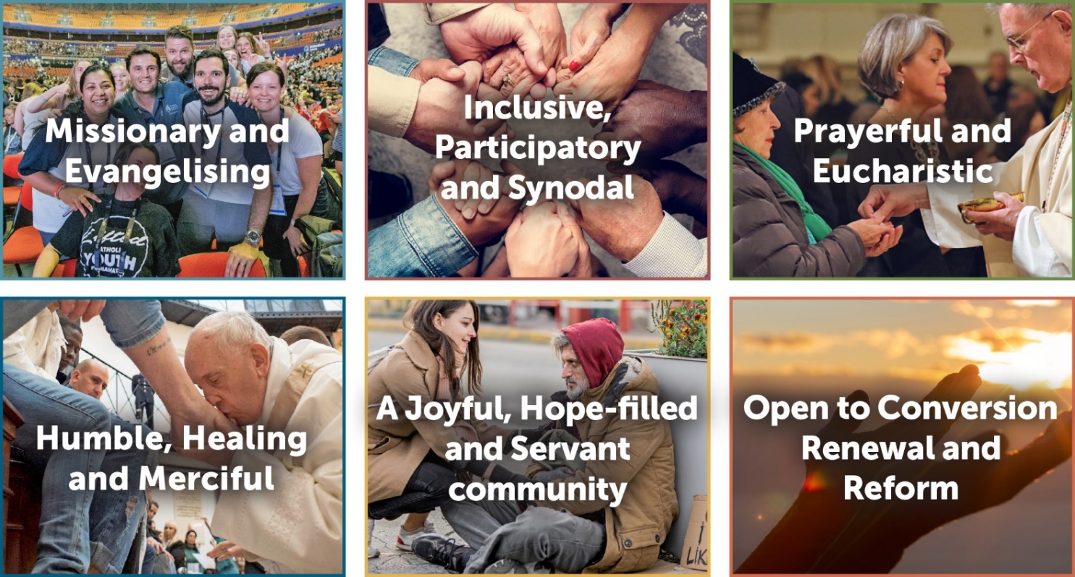


Let’s Listen & Discern
Guided Facilitation
Notes:
Welcome everyone to today’s Listening & Discernment Experience.
I appreciate the time you have all taken to be with us today.
Before we start, let’s take time to meet the people in our smaller groups – say hi and introduce yourself.

Slide 2
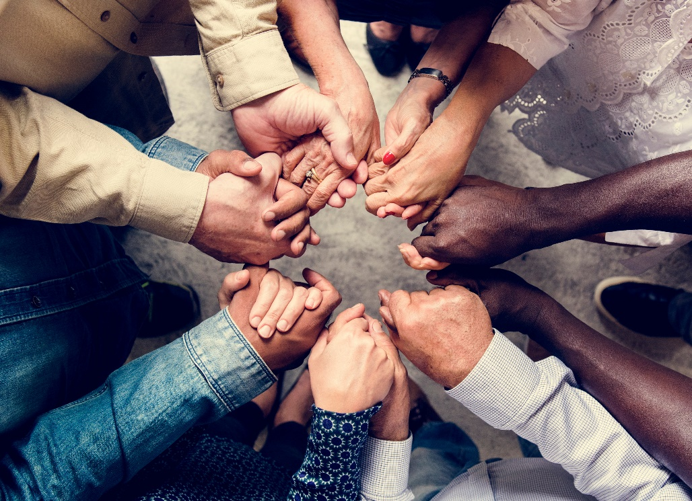
How is God calling us to be a Christ-centred Church that is
Inclusive, Participatory and Synodal?
Notes:
Today you have come together to discern the question, How is God calling us to be a Christ-centred Church that is Inclusive, Participatory and Synodal?
But before we start – let’s just take a brief moment to see where we have come from and look at where this session will lead us.

Slide 3


Introduction
1
Tell Us About You
What is the last Disney movie that you watched?
What superhero or cartoon character would you have been as a child and why?
Which song reminds you the most of your life?
8 mins
Notes:
Help the students get to know each other a little by asking them:
Start with their name and their school
Ask the students to answer these questions but you need to keep an eye on the time and move on when needed.

Slide 4
Introduction
1
Archbishop Message
What was the energy/standout from what the Archbishop said?
What did you really like or respond to?
Did anything “fire you up” a bit? Why?
5 mins

Slide 5

Let’s reflect
2
Scripture Passage
3 mins
1 Timothy 4:12
Don’t let anyone look down on you because you are young, but set an example for the believers in speech, in conduct, in love, in faith and in purity.
Notes:
Ask a student to read the scripture for everyone.

Slide 6

Let’s reflect
2
Individual Silent Reflection
During this time of silence, consider the question below. Using the post-it notes provided take your time to write down your thoughts.
8 mins
What do you find challenging about the way the church does or does not include and provide opportunities to participate in a Christ-centred Church?
Notes:
I’d like to invite you to listen to your truth, wisdom, insights on this topic by considering the question.
Use the post-it notes provided, ensuring that you write each thought/answer on an individual post-it note.

Slide 7
Let’s share & listen
3
Sharing and Listening, Round 1
From my time of reflection I would like to share…
2-3 mins per person
2-3 minutes per person where each person shares what is written on their post-it notes and places them in the middle – please keep an eye on time in each group.
Remember
- one person speaks at a time
- this time is for people to share their thoughts
Anyone in the group can begin, and the person on their left is the next person to share their post-it notes.
Continue clockwise around the circle, until each person in the group has had their turn.
Notes:
This is a time of sharing and listening not responding so the other members of the group need to refrain from commenting. This may be difficult for some students, but it is part of the practice of Spiritual Conversations and provides a way for groups of people to listen to God, by listening to one another. Students will have an opportunity to respond shortly after everyone has shared.

Slide 8
Let’s share & listen
3
Reflection time
What did I hear in common?
2 mins
Notes:
Reflect
2 mins
Once everybody has shared, the whole group reflects in silence for 2 minutes. During this time, think about what you have heard the people in your group say, and ask yourself:
- “What am I hearing the Holy Spirit saying to us?”
“What did I hear in common”
“What is the youth voice that I am hearing in regards to this topic?”

Slide 9
Let’s share & listen
3
Sharing and Listening, Round 2
Listening to the Holy Spirit through the voices of the group, we have heard…
15 mins
Move into pairs to share what you have heard in common.
When ready, each pair shares with the group with one student nominated as a scribe.
Remember
- one pair speaks at a time
- this time is for people to share their thoughts
Any pair in the group can begin, and the person on their left is the next person to share.
Continue clockwise around the circle, until each person in the group has had their turn.
Notes:
Sharing and Listening, Round 2
Invite students to talk to the person beside them and share what they heard in common. When you feel the time is right invite the pairs to share with the whole group, asking one student to be the scribe writing down what everyone heard in common.

Slide 10
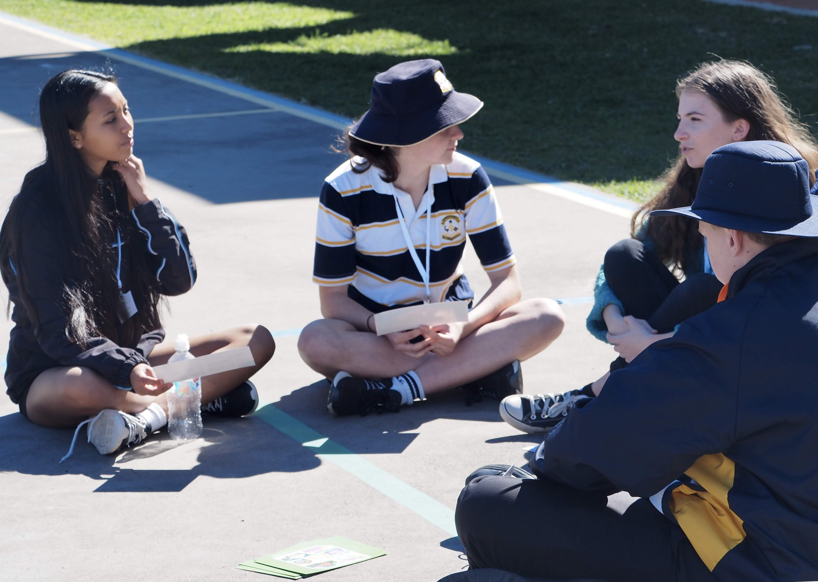
Let’s share & listen
3
Reflection time
How do you feel we went in listening to the common voice in the group?
2 mins
Notes:
Reflect
Once everybody has shared, the whole group reflects in silence for 5 minutes.
How do you think we went from a discernment point of view?
Were we listening and discerning?
How did we go?
Share some simple appreciations.

Slide 11
Lunch Time

Slide 12
How is God calling us to be a Christ-centred Church that is
Inclusive, Participatory and Synodal?
Notes:
So, let’s now take a moment to settle our minds and ourselves before we commence the Group Discernment phase of today.

Slide 13
Let’s think about “actions”
4
Sharing and Listening, Round 3
In our discussion before lunch we heard…
5 mins
During this time, reflect on the summary page remembering to listen deeply when someone else is speaking, and to respond to the conversation with an open and kind heart.
Notes:
Invite the students to take a quick look at and comment on the summary page of what they heard in common. Remember to encourage students to listen deeply when someone else is speaking, and to respond to the conversation with an open and kind heart.

Slide 14
Let’s think about “actions”
4
Reflection time
What topic within this theme has the most energy for you and why?
Write one (1) topic on your card.
How is God calling us to be a Christ-centred Church in Australia that is
Inclusive, Participatory and Synodal?
Consider examples of good practice or programs, locally, nationally or globally that you are aware of that could be explored?
5 mins
Notes:
The whole group reflects in silence for 5 minutes. During this time, think about the concrete, practical steps which could be taken to move forward in the thematic area you have been focused on today.
For example: If you have been discerning participatory and synodal ways of engaging young people, some practical suggestions might be to form a state-based peer-to-peer encounter network for young parents, or explore the development of an online faith platform to support young people’s mental health, church partnership with Beyond Blue etc.
Consider the questions below and write your ideas on paper or post-it notes.
How is God calling us to be a Christ-centred Church in Australia that is (insert: National Theme for Discernment)?
What are some examples of good practice or programs, locally, nationally or globally that you are aware of that could be explored?
Identify the topic that received the most ticks as this will be one your group will focus on.

Slide 15
Let’s think about “actions”
4
Reflection time
What is a simple doable action that we as a faith community could engage in that addresses this topic and leads to our community – locally (at your school or parish) or nationally becoming more inclusive and participatory?
5 mins
Notes:
Remind students of the difference between an outcome and an action. The action needs to be:
1. Clear
2. Stated as a positive
3. As specific as possible
4. A real action (practical, achievable and measurable)

Slide 16
Let’s think about “actions”
4
Sharing and Listening
Each person in the circle takes 2-3 minutes to share their idea with the group.
Place your card in the centre of the group as you speak about them.
Anyone in the group can begin, and the person on their left is the next person to share.
Continue clockwise around the circle, until each person in the group has had their turn.
10 mins
Notes:
Once these are finished place them on the floor in the middle of the group. Each person quickly talks about what their practical doable idea linked to this topic would be.

Slide 17
Let’s think about “actions”
4
Group Discussion, Towards Decision
20 mins
Which action do we feel strongly called towards?
Which action could really help us to move toward becoming a Christ-centred Church which is
Inclusive, Participatory and Synodal?
What is the most open, compassionate and loving response that the Spirit is calling us to?
Notes:
Talk through the actions allowing all students to offer their comments, suggestions and questions making the space for all possibilities.
Similarly to before, ask students to tick the two actions they feel are most doable and practicable. Again, remind the students not to be concerned if their action is not chosen, as they can take it back to the school, parish and community to explore it further.

Slide 18
Let’s think about “actions”
4
Group Discussion, Towards Decision
20 mins
What is the action?
When might it take place?
Where might it take place?
What will we need to make it work/happen?
Who will action it?
How will we do it?
Notes:
Identify the action (or combination of actions) that have been chosen to go forward and shape a fifty-word summary of the action. The following process below will help scaffold the writing of this summary.

Slide 19
Let’s think about “actions”
4
Remember, these actions need to be:
Clear
Stated as a positive
As specific as possible
A real action (practical, achievable and measurable)

Slide 20
Let’s think about “actions”
4
4
Let’s think nationally
Reflection
5 mins
How do I feel about our proposed action, our group decision?
Notes:
Invite the students to reflect on their listening discernment process.
Conclude with simple appreciations.

Slide 21
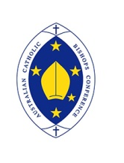

Thank you for your participation today, and for your ongoing engagement with the Plenary Council 2020 journey.

